Slide 1
Lasers for
a better life

Slide 2
PowerLaserTM
Pro500
Particularly effective for treatment of: - Trigger points - Between smaller joints - Ear problems

Slide 3
Lasers for
a better life

Slide 4
PowerLaserTM
Pro1500
Exceptionally effective for treatment of: - Muscle tensions - Low back pain - Acute sports injuries

Slide 5
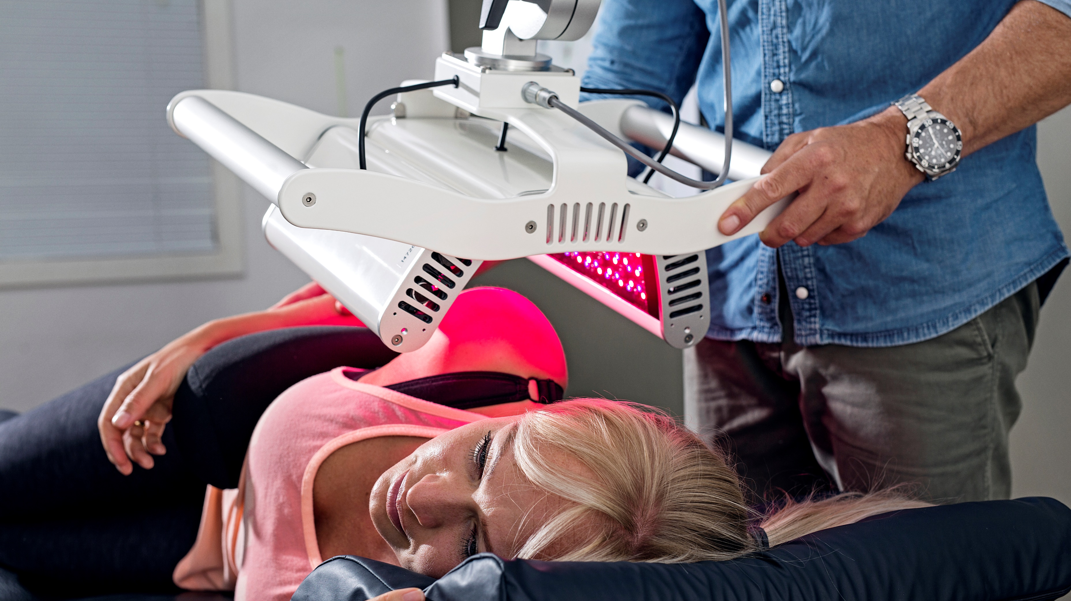
Lasers for
a better life

Slide 6
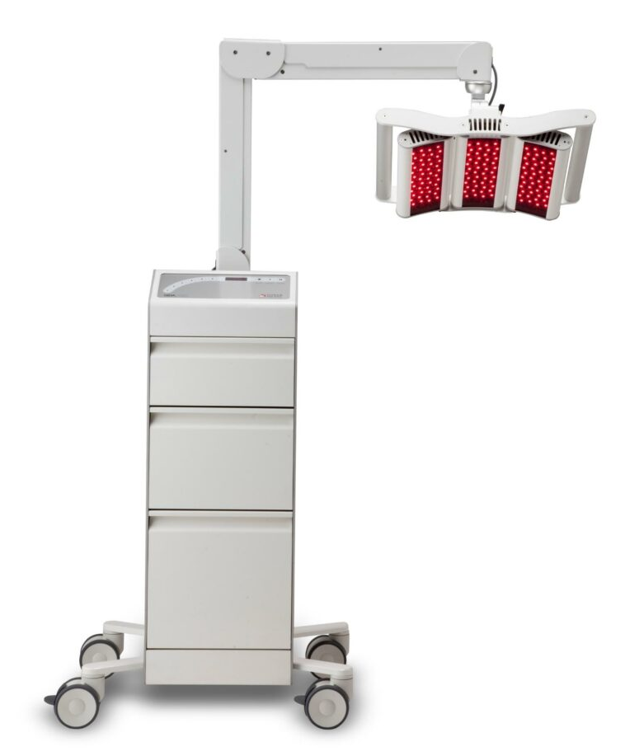
GigaLaserTM
Extremely effective for large area: - Pain management - Sports injuries - Skin disordes
- Fertility

Slide 7
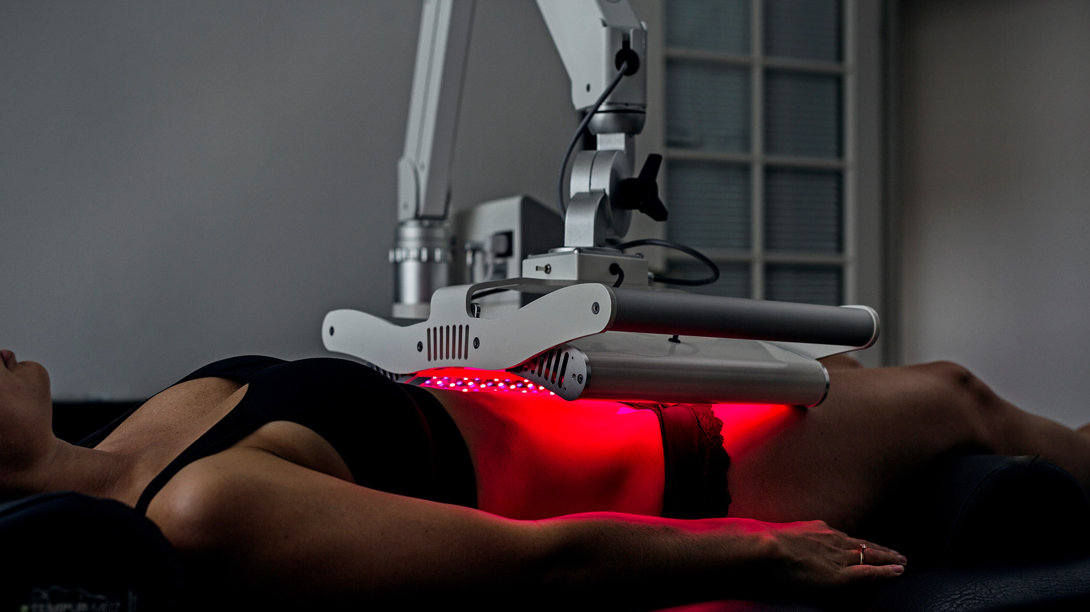
Lasers for
a better life

Slide 8
GigaLaserTM
Very large area therapy laser,
combining 18W laser
with red & blue LED

Slide 9
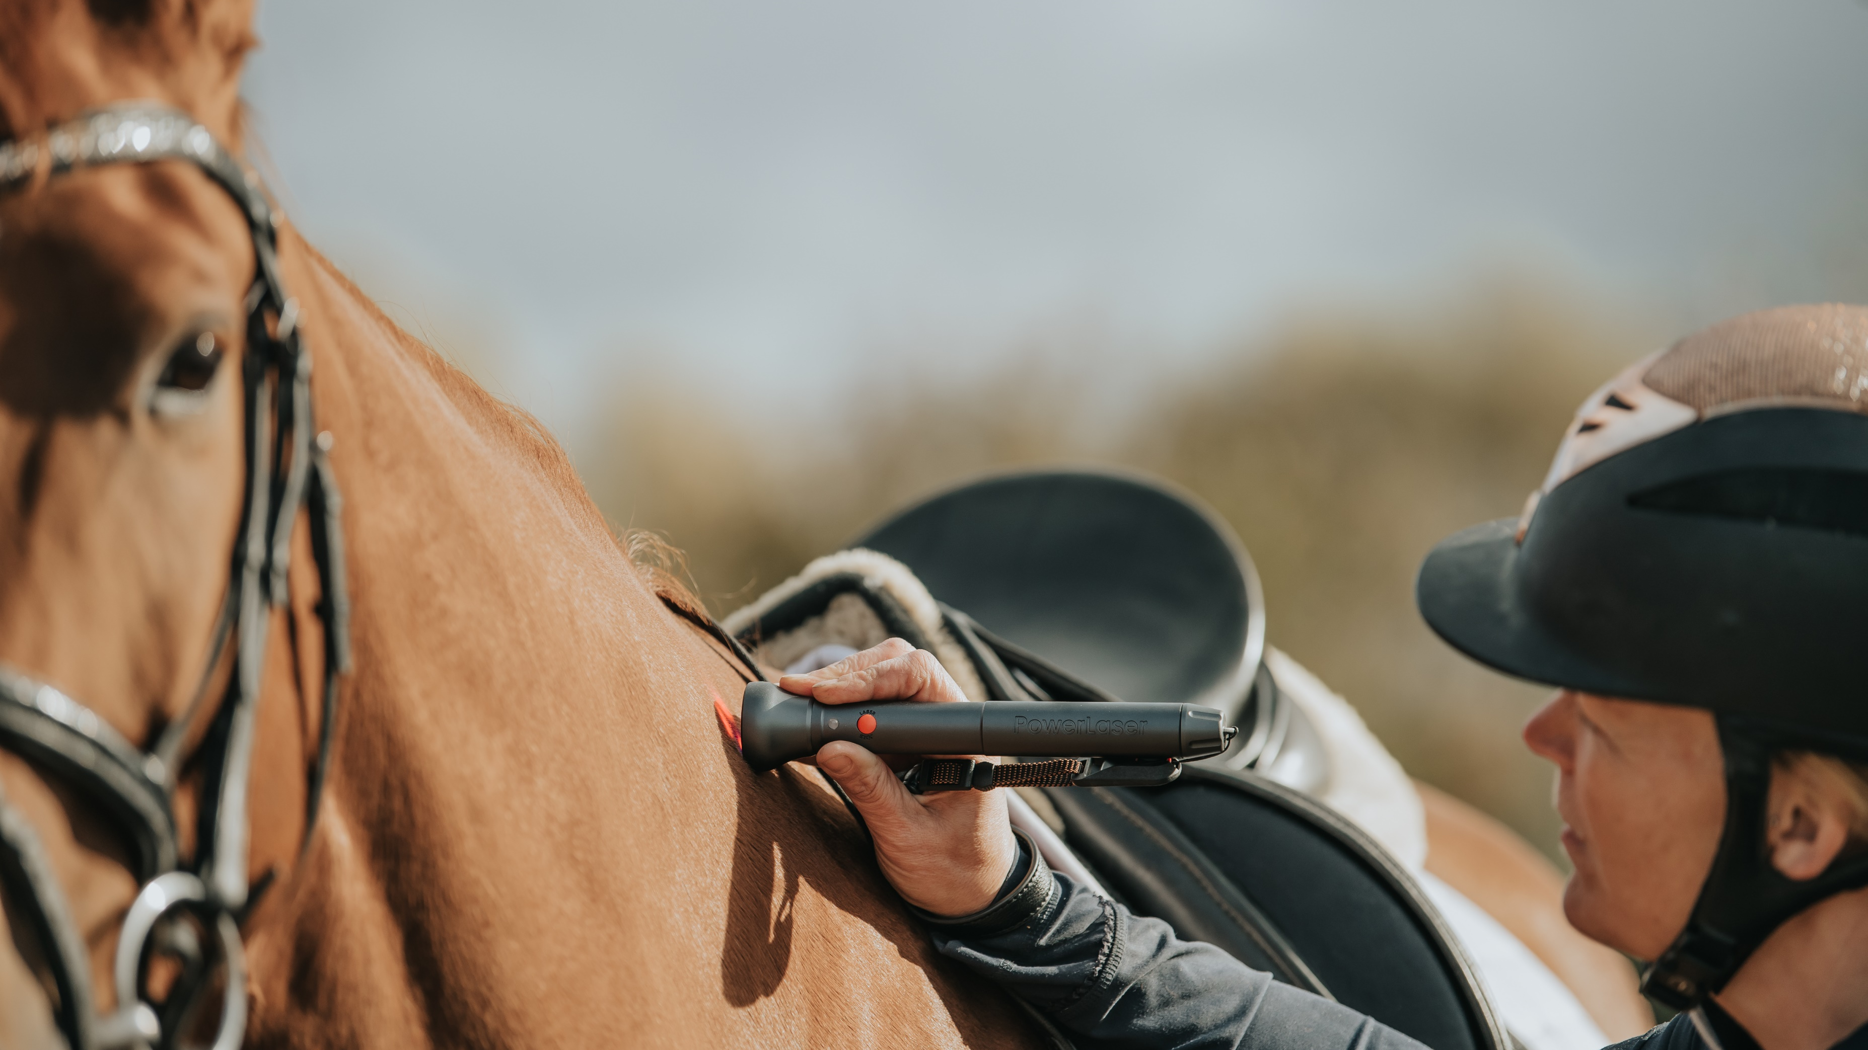
Lasers for
a better life
Lasers for
a better life

Slide 10
PowerLaserTM Basic1500 VET
Deep tissue treatment, particularly effective for: - Bruises - Swellings - Muscle tensions

Slide 11
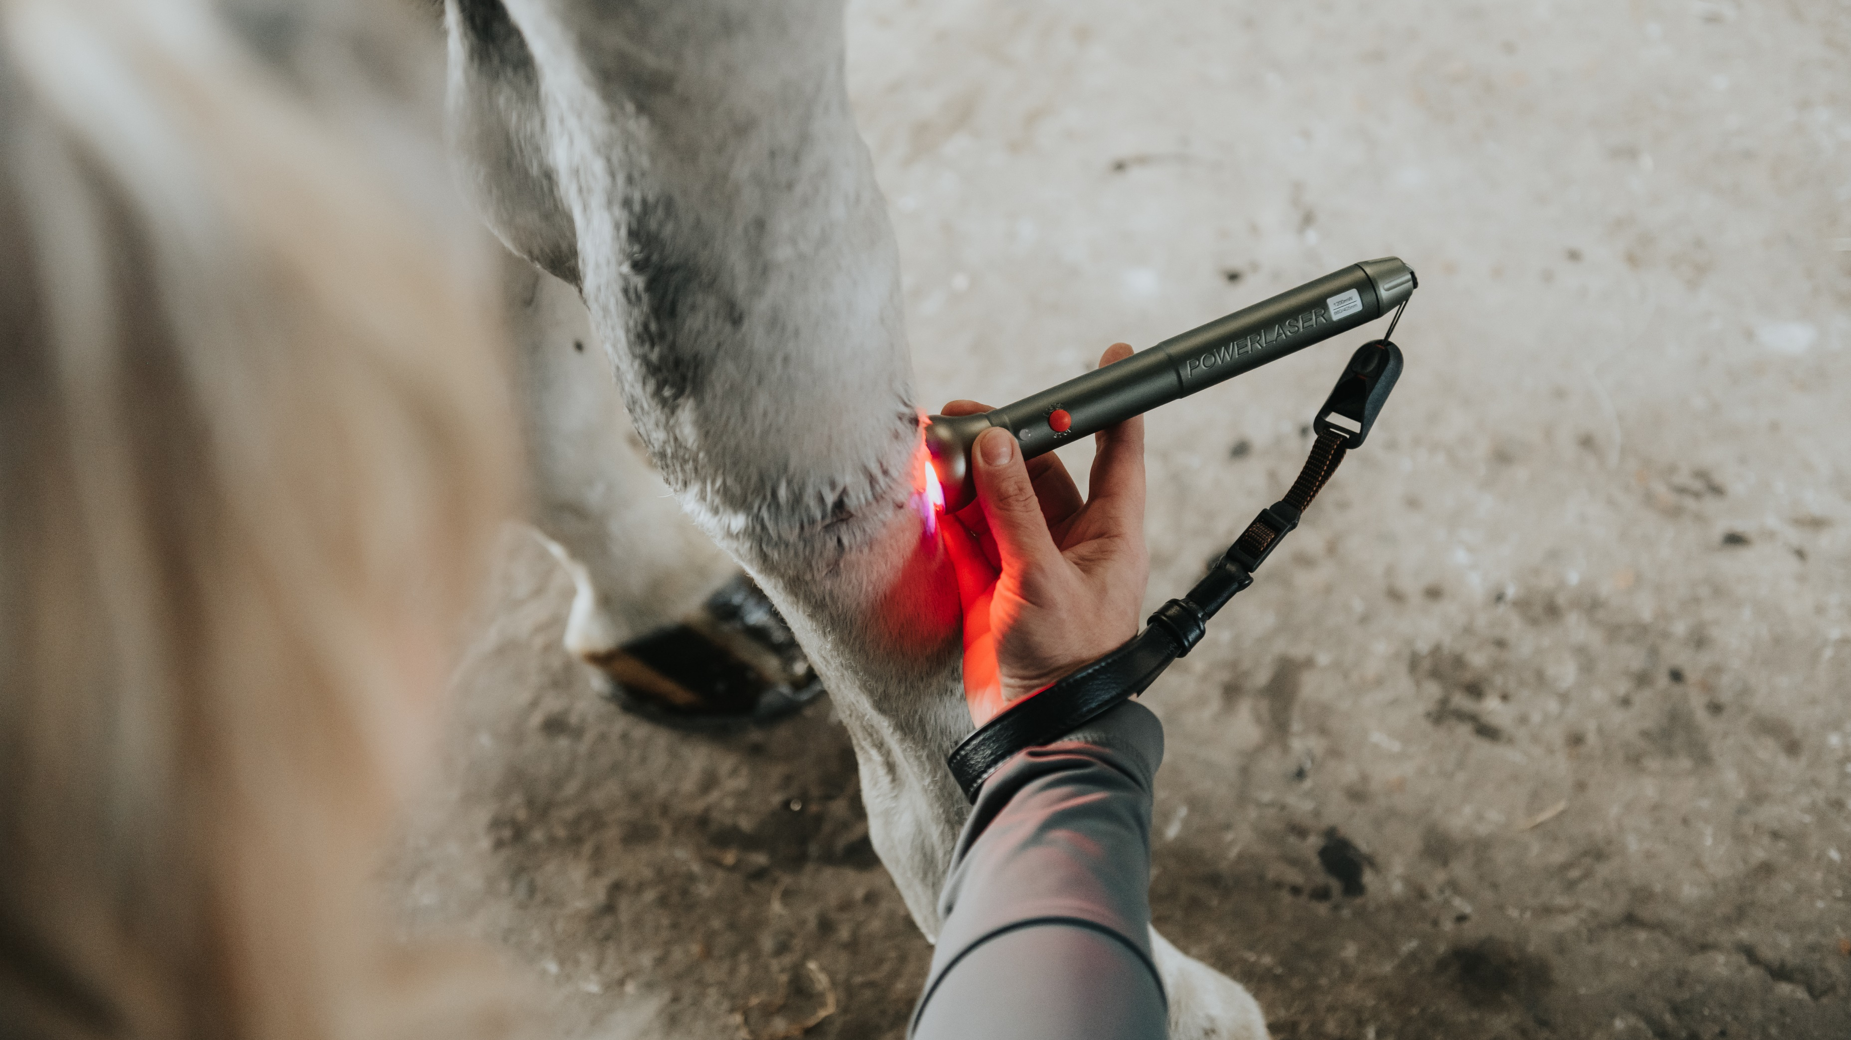
Lasers for
a better life

Slide 12
PowerLaserTM Basic1200 VET
Red laser + blue LED,
exceptionally effective for: - Wounds - Rashes - Eczema

Slide 13
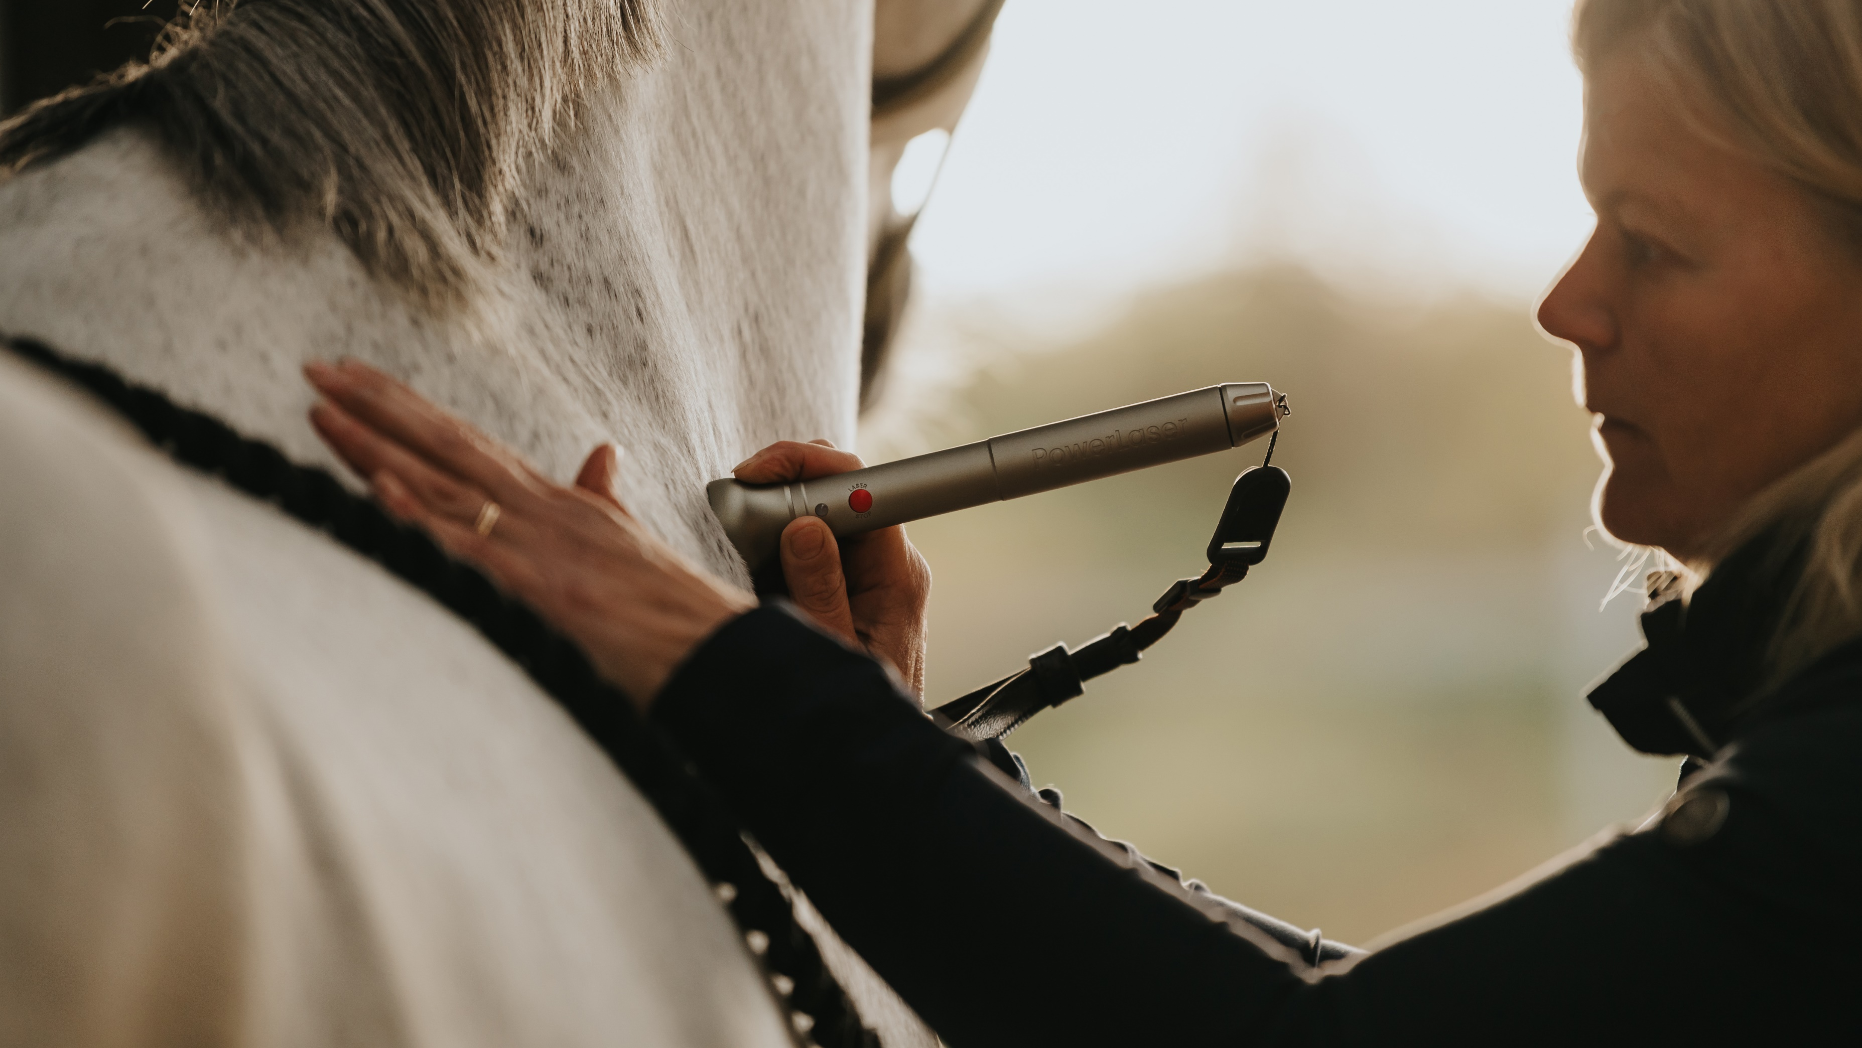
Lasers for
a better life

Slide 14
PowerLaserTM Basic500 VET
Exceptionally effective for: - Teeth problems
- Ear disorders - Smaller wounds

Slide 15
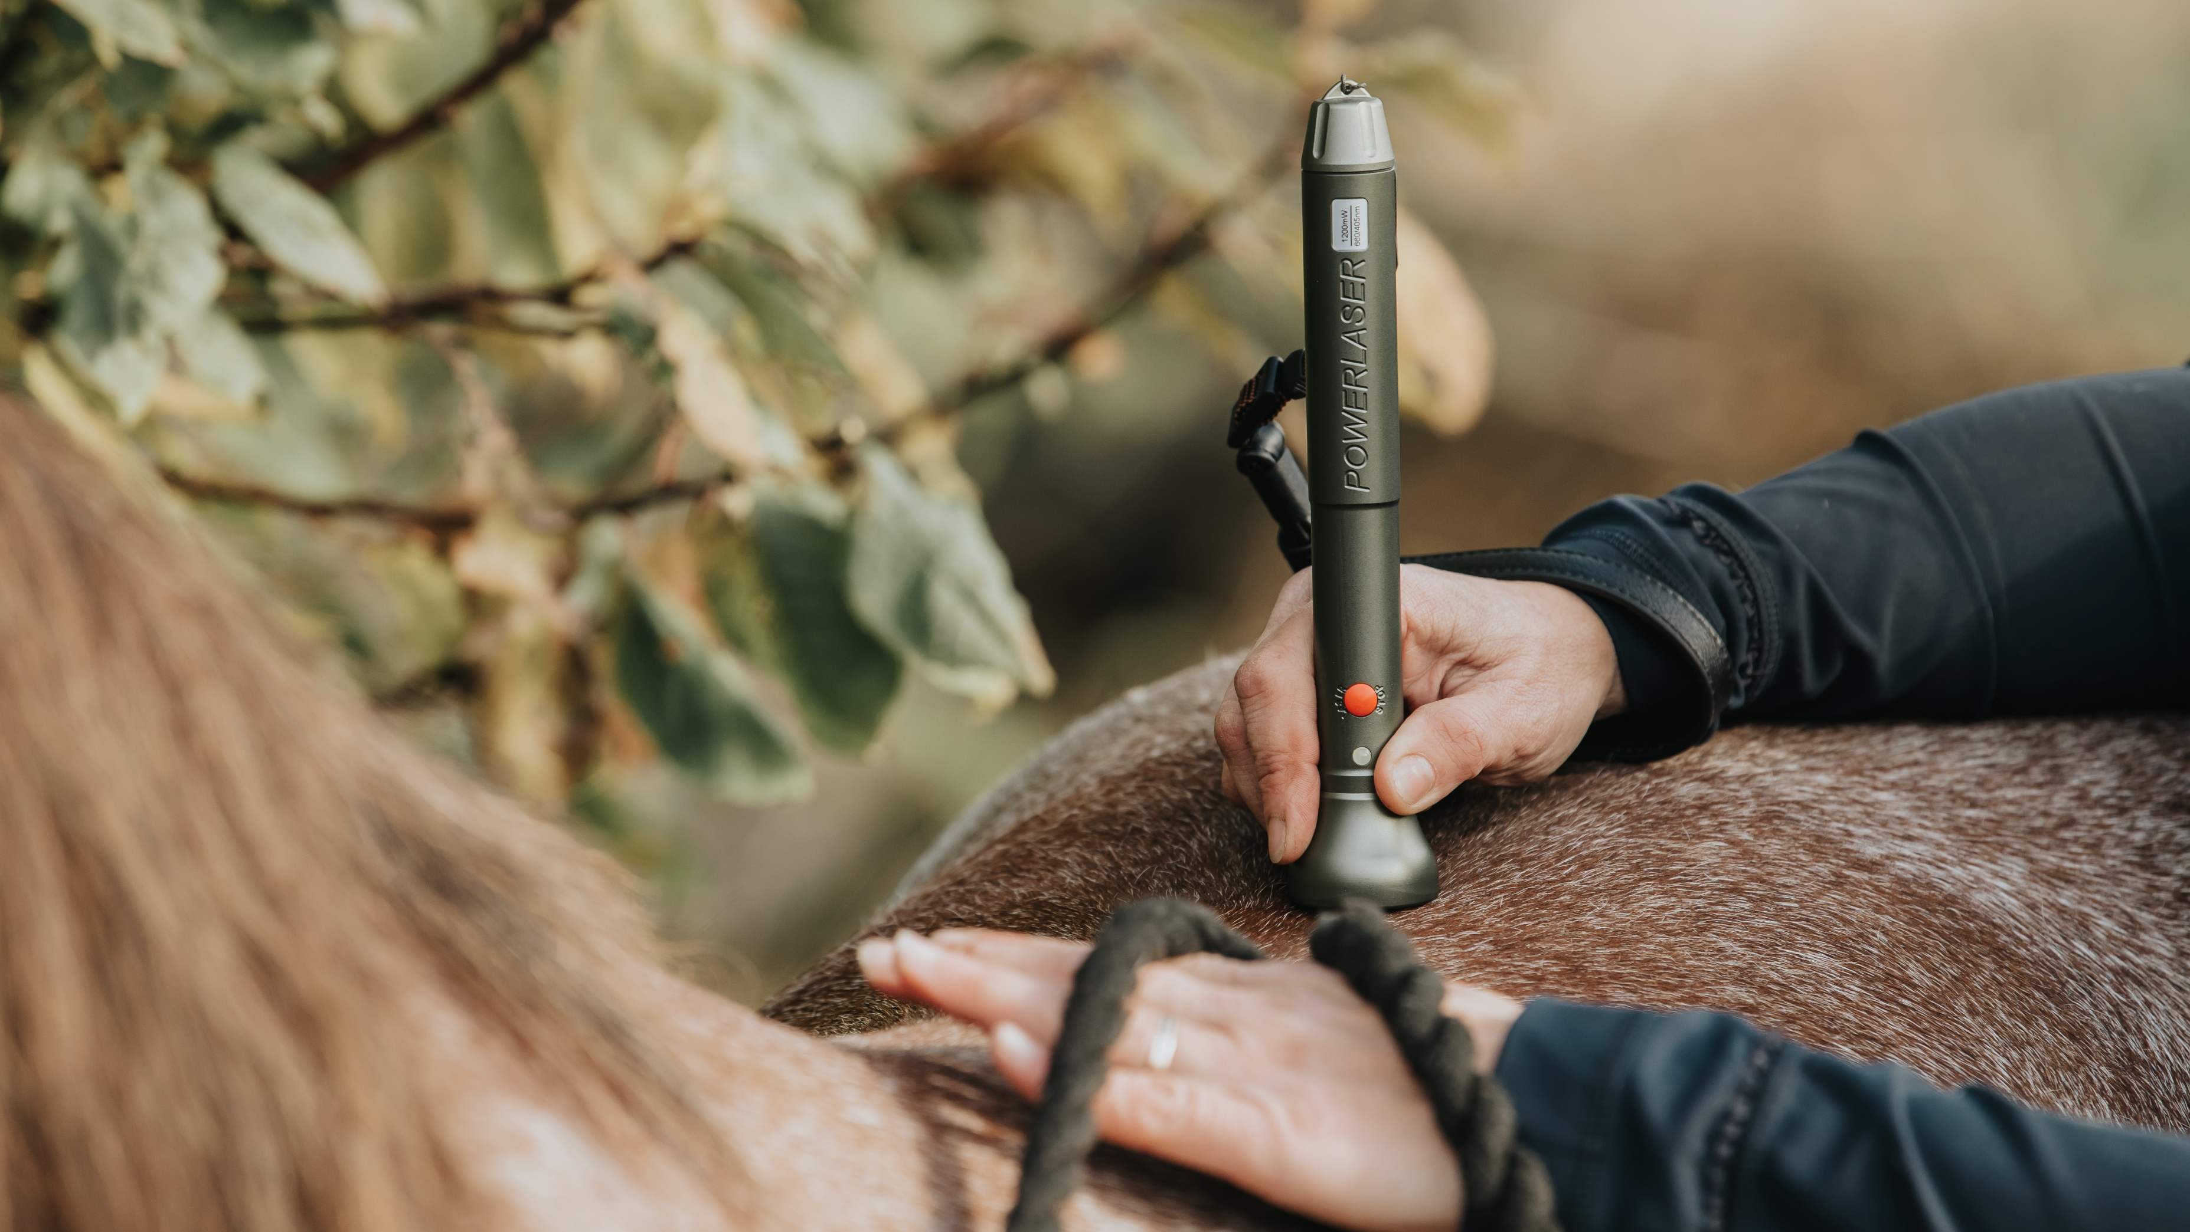
Lasers for
a better life

Slide 16
PowerLaserTM Basic VET Series
Handy, portable & effective for horses and pets
PowerLaserTM Basic500 VET
PowerLaserTM Basic1500 VET
PowerLaserTM Basic1200 VET

Slide 17
Lasers for
a better life

Slide 18
www.powermedic.com info@powermedic.com +45 59 45 64 00

